Slide 1
Stimuli

Slide 2
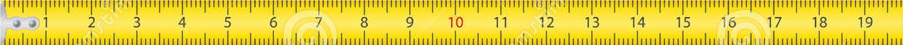

Slide 3





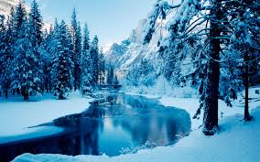
Instructions
In addition, the aliens’ planet goes through different seasons, and aliens will need different things depending on these seasons!
For example, one alien might need to swim in a mud puddle in the hot season, but it needs to sleep in a bed during the rainy season in order to grow.

Slide 4

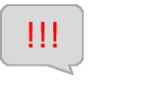
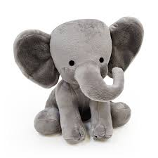
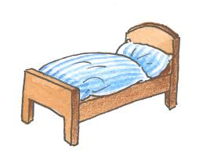
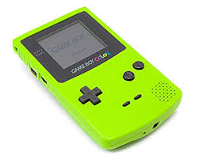


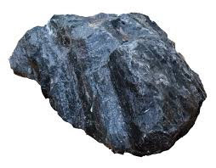

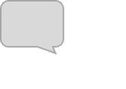
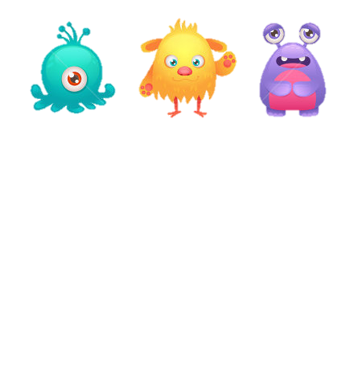

Slide 5

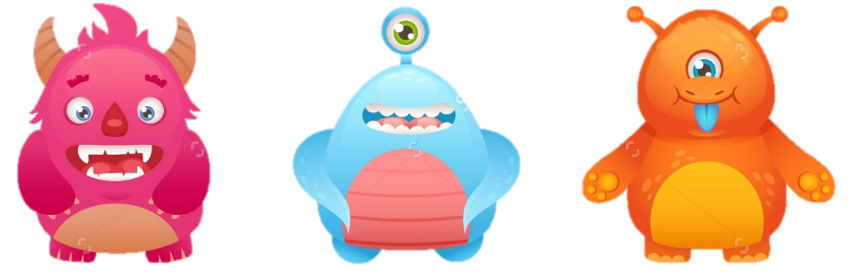

Slide 6



Slide 7


Slide 8
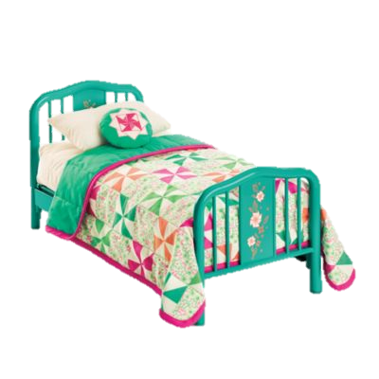
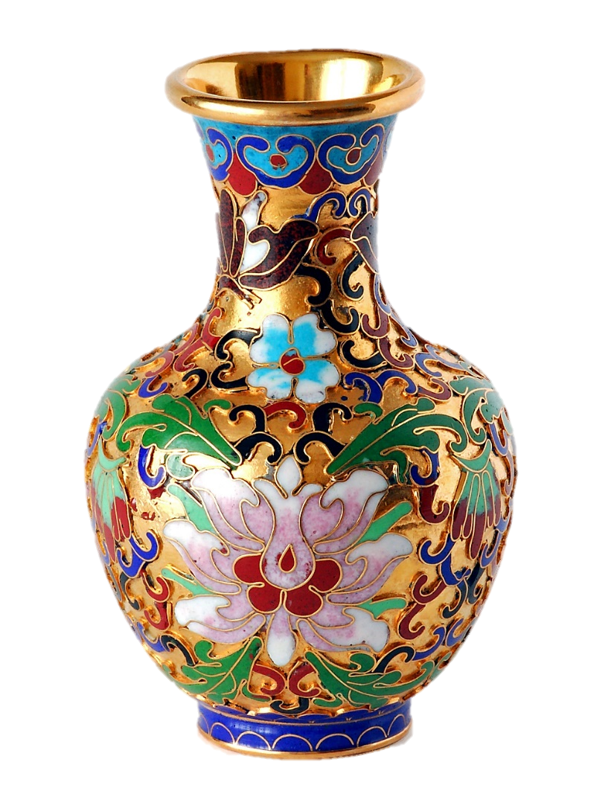

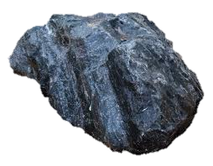
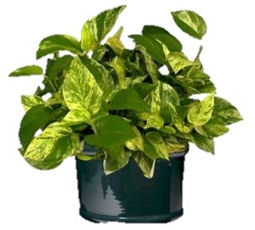
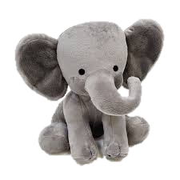

Slide 9
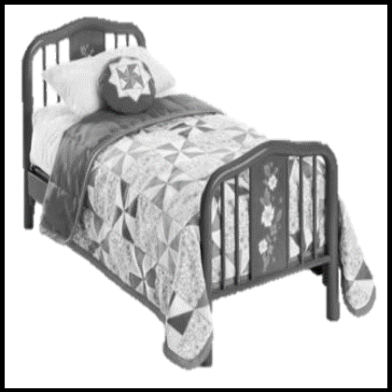

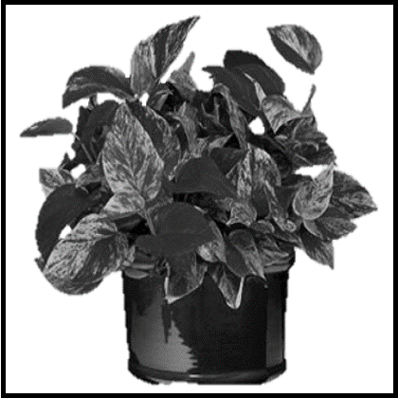
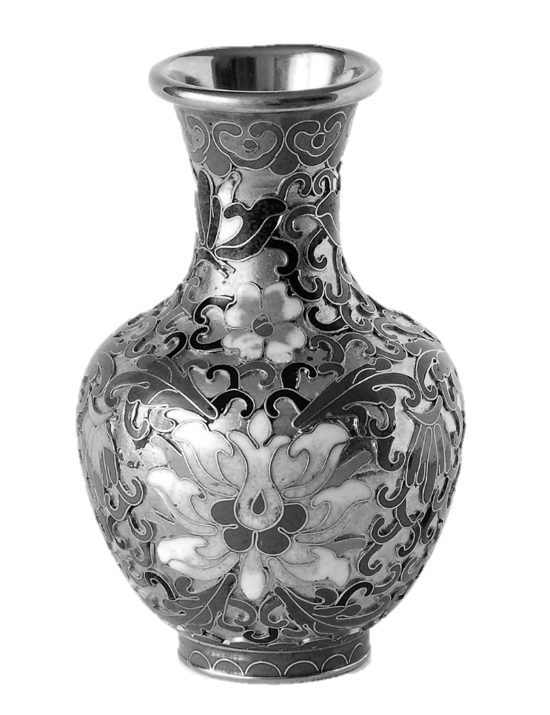

Slide 10







a
c
TS0: 25
TS2: 15
6 | 1 | 1 | 1
1 | 4 | 1 | 1
1 | 1 | 5 | 10
1 | 1 | 3 | 1
7 | 1 | 1 | 1
1 | 3 | 1 | 2
b
TS1: 20
d
6 + 2 + 7 | 4 + 8 + 3 | 5 + 7 + 3 | 10 + 3 + 2
15 | 15 | 15 | 15
1 | 8 | 1 | 3
2 | 1 | 7 | 1
1 | 1 | 1 | 1
5 + 10 + 3 + 2 | 6 + 8 + 3 + 3 | 4 + 2 + 7 + 7
20 | 20 | 20

Slide 11



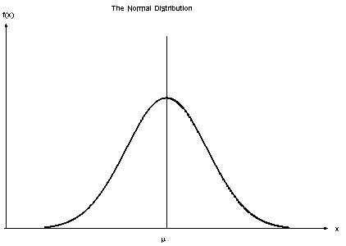
TS1
TS2
TS0
TS1
TS2
1
1
6 | 4 | 5 | 10
2 | 8 | 7 | 3
7 | 3 | 3 | 2
6.25
5
3.75

Slide 12
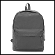
TS6
TS5
TS4
6 | 4 | 5 | 10
2 | 8 | 7 | 3
7 | 3 | 3 | 2
6.25
5
3.75

Slide 13
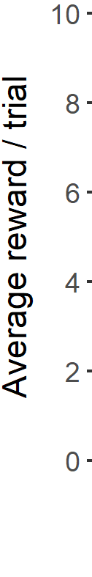
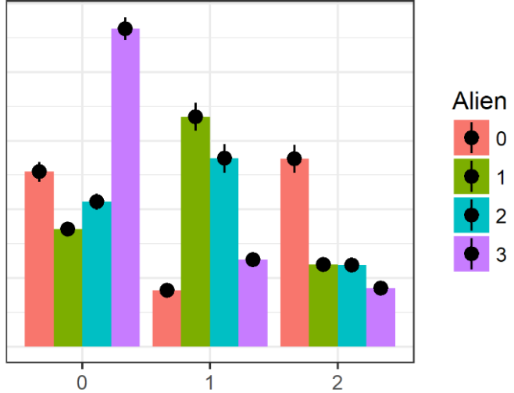
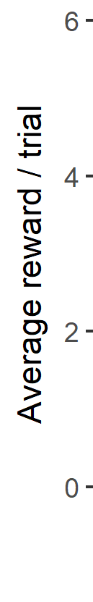
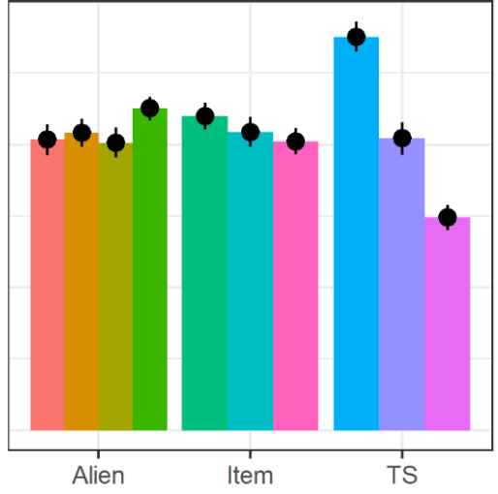
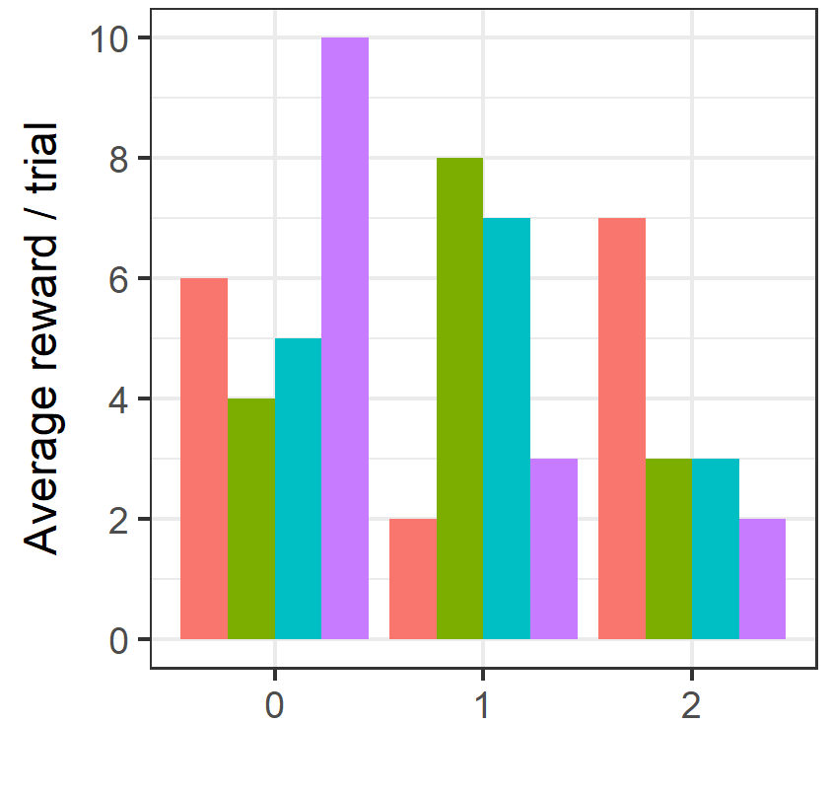
A
B
Average reward / trial
TS0
TS1
TS2
…
TS0
TS1
TS2
…
…
…
…
Average reward / trial
6 | 4 | 5 | 10
2 | 8 | 7
6.25
5
3.75
Aliens
Items
TS

Slide 14
TS1
TS2
TS0
TS1
TS2
6 | 1 | 1 | 1
1 | 4 | 1 | 1
1 | 1 | 5 | 10
1 | 8 | 1 | 3
2 | 1 | 7 | 1
1 | 1 | 1 | 1
1 | 1 | 3 | 1
7 | 1 | 1 | 1
1 | 3 | 1 | 2
6.25
5
3.75

Slide 15
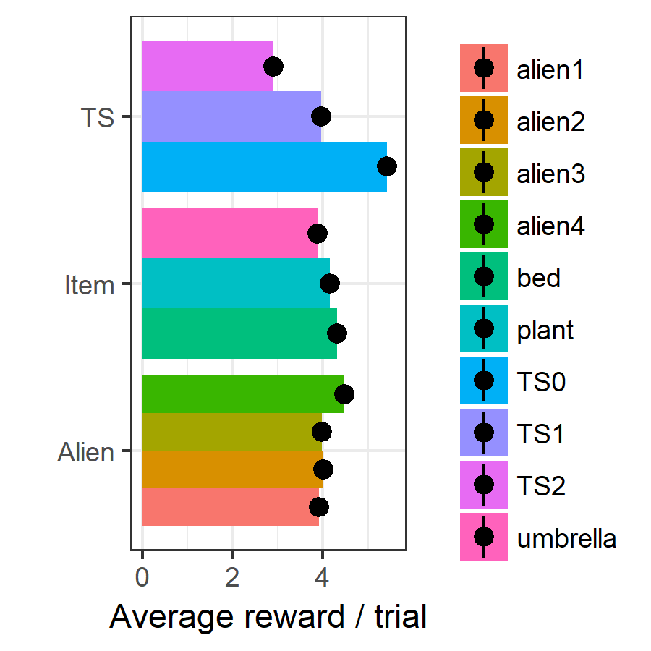



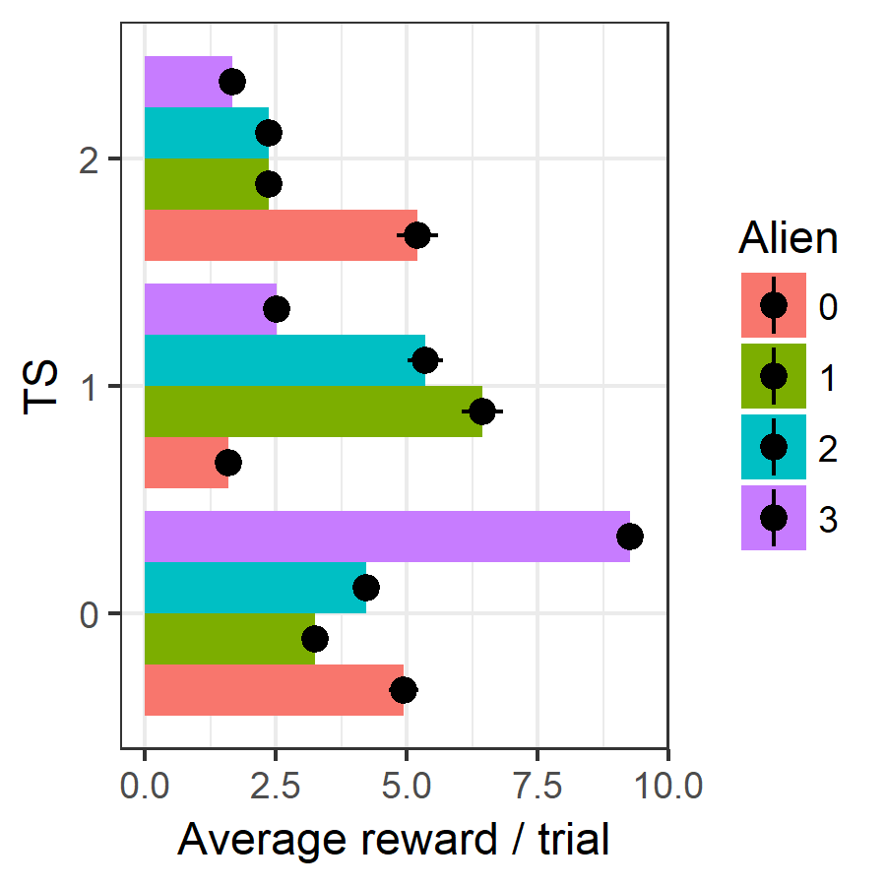
6 + 4 + 5 + 10 | 2 + 8 + 7 + 3 | 7 + 3 + 3 + 2
6.25 | 5 | 3.75
6 + 2 + 7 | 4 + 8 + 3 | 5 + 7 + 3 | 10 + 3 + 2
5 | 5 | 5 | 5
5 + 10 + 3 + 2 | 6 + 8 + 3 + 3 | 4 + 2 + 7 + 7
5 | 5 | 5

Slide 16
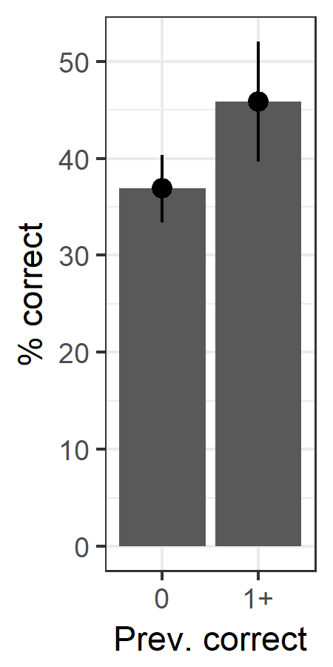
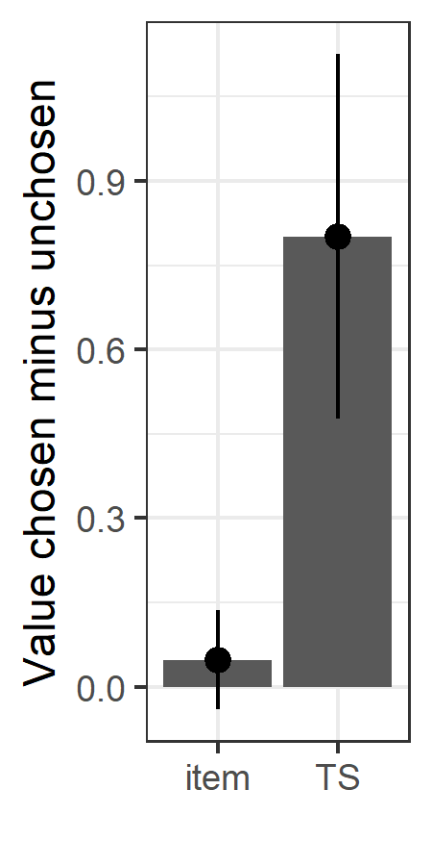
*
*
n.s.

Slide 17
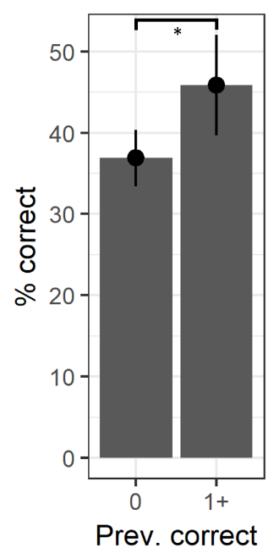
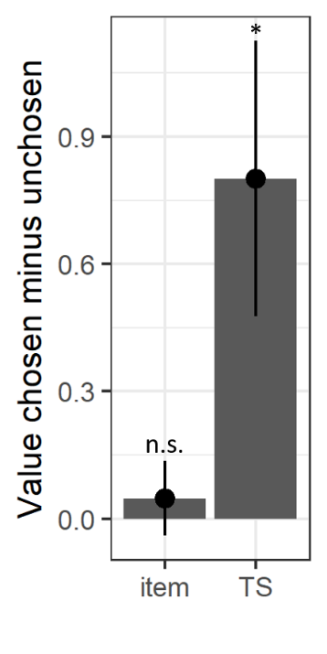
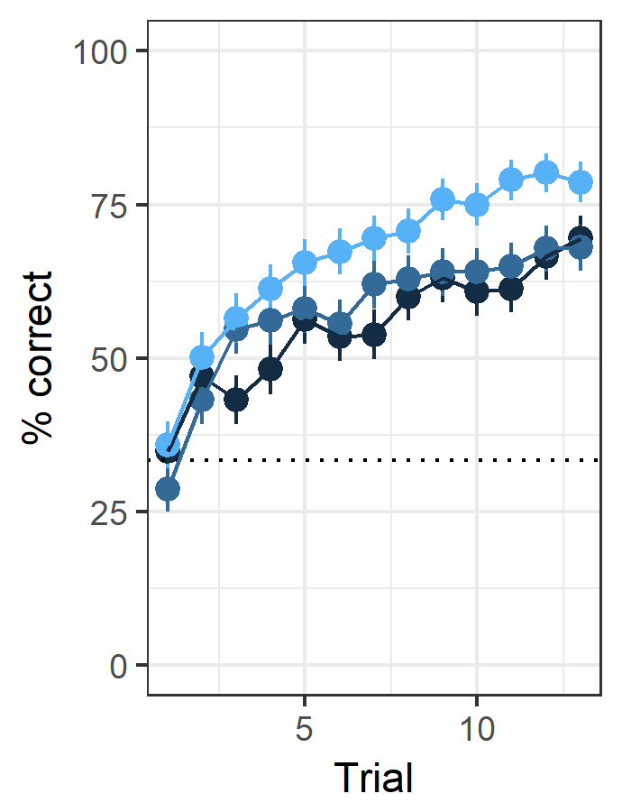
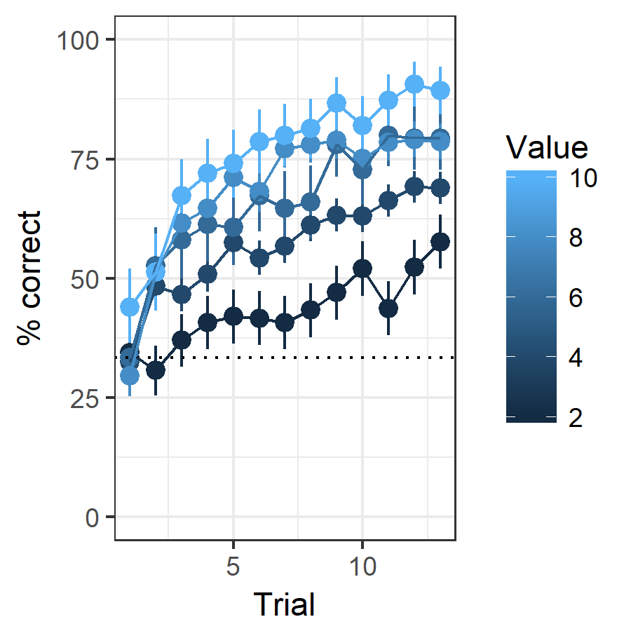
A
TS values
Stimulus values
B
C
6.25
5
3.75
10
8
6
4
2

Slide 18
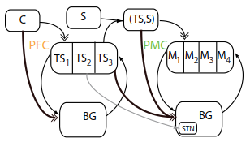

Slide 19
Context
TS
Alien
TS0
TS1
TS2
Item1
Item2
Item3
Item4
Feedback

Slide 20
Context
TS0
TS1
TS2
Select according to TS values
Stimulus
TS
Action
Action1
Action2
Action3
Select according to action values
Update TS values
Feedback
Update action values

Slide 21
Context
TS0
TS1
TS2
Select accord. to TS values
Stimulus
TS
Action
Action1
Action2
Action3
Select acc. to action values
Update TS values
Feedback
Update stimulus values

Slide 22
Context
TS0
TS1
TS2
Select according to TS values
Alien
TS
Item1
Item2
Item3
Item4
Select according to action values
Update stimulus values
Update TS values
Item
Feedback

Slide 23

Context
TS0
TS1
TS2
Select according to TS values
TS
Stimulus
Action1
Action2
Action3
Select according to action values
Action
Update TS values
Feedback
Update action values

Slide 24
Context
TS0
TS1
TS2
Select according to TS values
TS
Stimulus
Action1
Action2
Action3
Select according to action values
Action
Update TS values
Feedback
Update action values

